Slide 1
Book Review: The Hundred-Page Machine Learning Book
Scott O’Hara
Metrowest Developers Machine Learning Group
11/18/2020

Slide 2
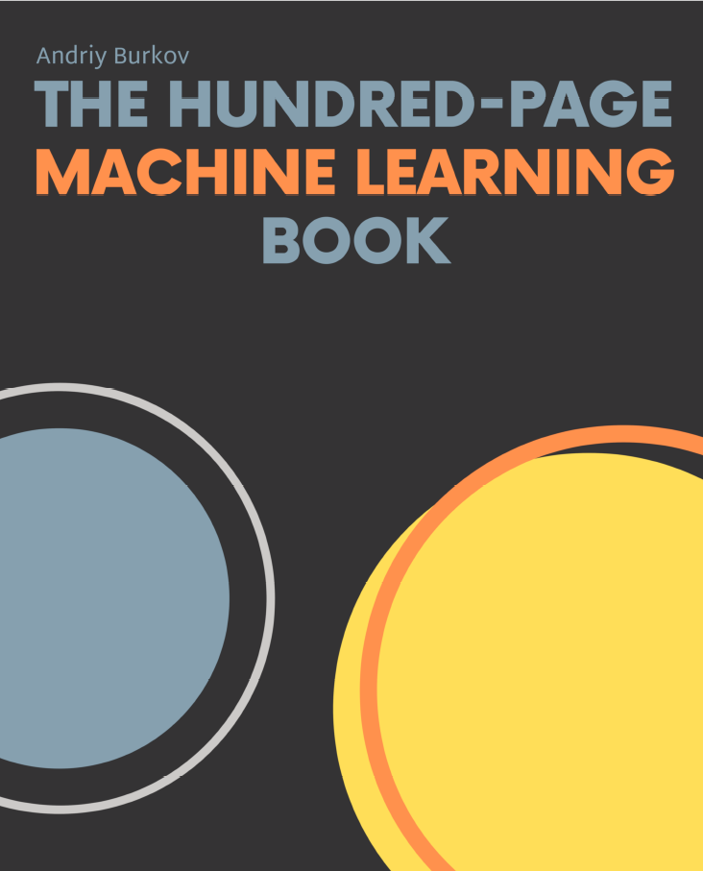
Concise definitions and well-thought-out examples.
~140 pages.
Covers mostly supervised learning.
Provides pointers to things it doesn’t cover.
Generally, a good summary of things you should know about ML.

Slide 3
Contents
Chapter 1: Introduction
Chapter 2: Notation and Definitions
Chapter 3: Fundamental Algorithms
Chapter 4: Anatomy of a Learning Algorithm
Chapter 5: Basic Practice
Chapter 6: Neural Networks and Deep Learning
Chapter 7: Problems and Solutions
Chapter 8: Advanced Practice
Chapter 9: Unsupervised Learning
Chapter 10: Oher Forms of Learning
Chapter 11: Conclusion

Slide 4
Chapter 3: Fundamental Algorithms
Linear Regression
Logistic Regression
Decision Trees
Support Vector Machine
k-Nearest Neighbors

Slide 5
Chapter 5: Basic Practice
Feature Engineering
One-Hot Encoding
Binning
Normalization
Standardization
Dealing with Missing Features
Data Imputation Techniques
Learning Algorithm Selection
Three Sets (Training Set, Validation Set, Test Set)
Underfitting and Overfitting
Regularization
Model Performance Assessment
Hyperparameter Tuning

Slide 6
Chapter 6: Neural Networks and Deep Learning
Multilayer Perceptron Example
Feed-Forward Neural Network Architecture
Convolutional Neural Network
Recurrent Neural Network

Slide 7
The Book has a Website
http://themlbook.com/

Slide 8
The Book has WIKI Page
http://themlbook.com/wiki/doku.php

Slide 9
The Book has GITHUB Repository
https://github.com/aburkov/theMLbook

Slide 10
Neural Networks

Slide 11
Neural Networks

Slide 12
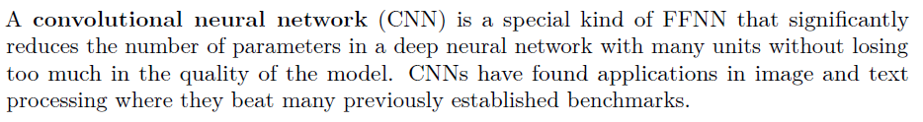
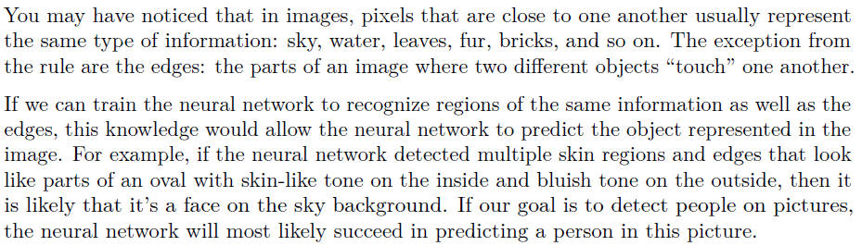
Convolutional Neural Networks

Slide 13

Typical CNN Architecture
Wikipedia contributors. "Convolutional neural network." Wikipedia, The Free Encyclopedia. Wikipedia, The Free Encyclopedia, 12 Nov. 2020. Web. 19 Nov. 2020.

Slide 14
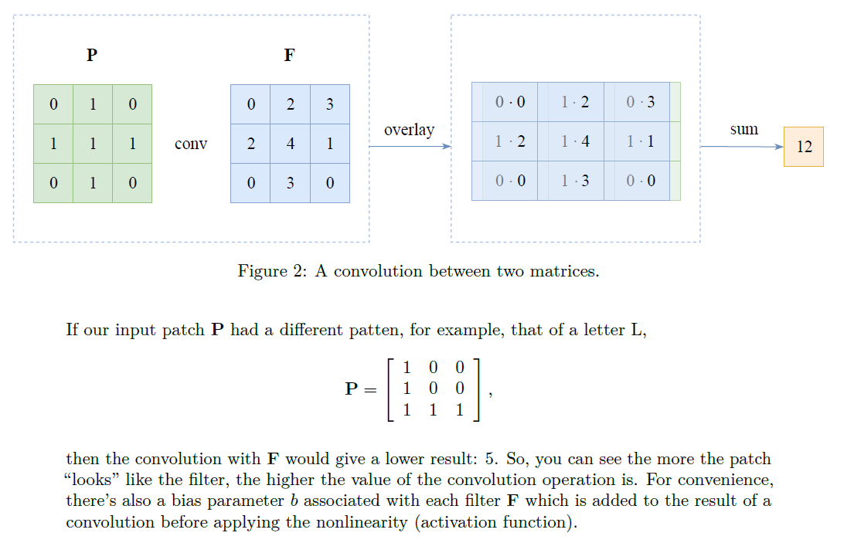
Convolutional Neural Networks

Slide 15
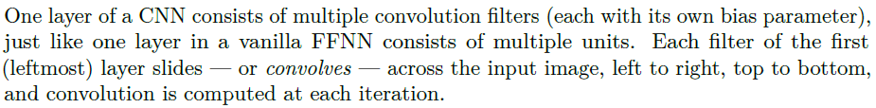
A Filter Convolving across an Image

Slide 16
A Filter Convolving across an Image

Slide 17
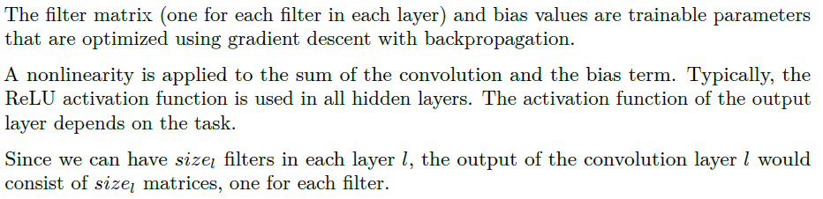
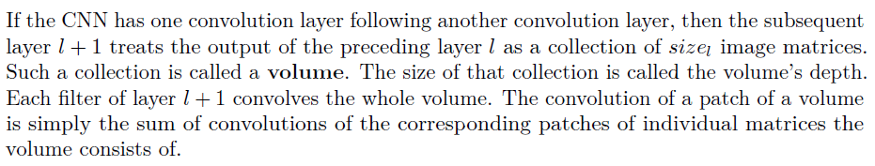
A Filter Convolving across an Image

Slide 18
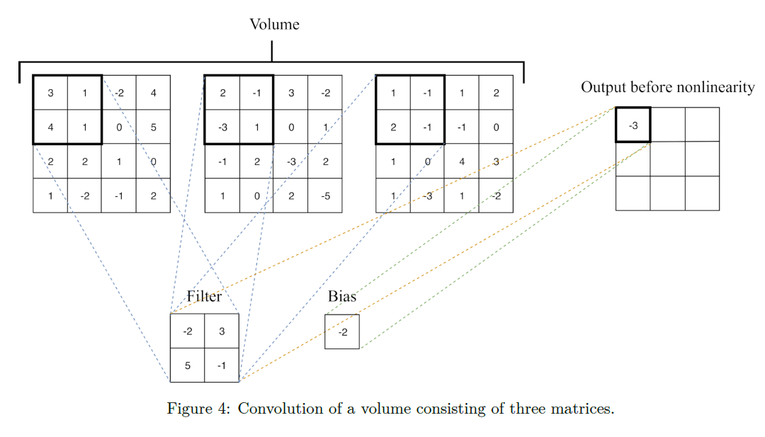
Convolution of a Volume

Slide 19
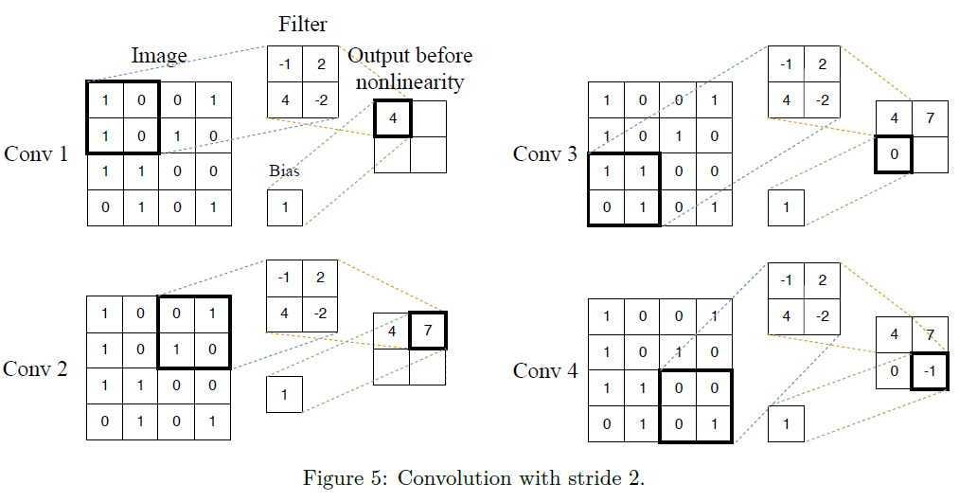
Stride
Stride is the step-size of the moving window.

Slide 20
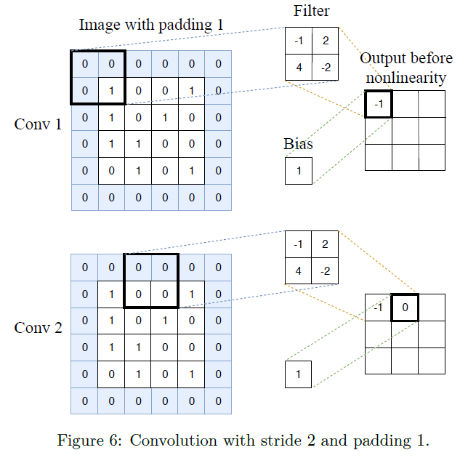
Padding
Padding allows getting a larger output matrix; it’s the width of the square of additional cells with which you surround the image
(or volume) before you convolve it with the filter.
The cells added by padding usually contain zeroes.

Slide 21
Pooling
Pooling works in a way very similar to convolution, as a filter applied using a moving window approach. However, instead of applying a trainable filter to an input matrix or a volume, pooling layer applies a fixed operator, usually either max or average.

Slide 22
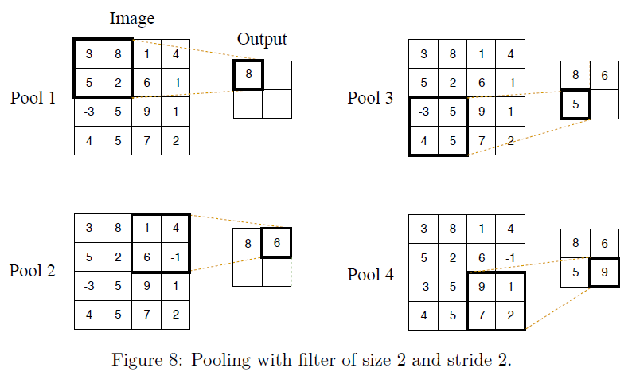
Pooling

Slide 23
Pooling
Usually, a pooling layer follows a convolution layer, and it gets the output of convolution as input. When pooling is applied to a volume, each matrix in the volume is processed independently of others. Therefore, the output of the pooling layer applied to a volume is a
volume of the same depth as the input.
Typically pooling contributes to the increased accuracy of the model. It also improves the speed of training by reducing the number of parameters of the neural network.

Slide 24
Conclusions
I recommend the book for the care in which Burkov has paid to defining terms and choosing instructive examples.
Machine learning can’t really be covered in a hundred pages, but the attempt to boil things down is worth it.
This might be a good book to review if you are preparing for an interview.

